Slide 1


Map your world
with
July 2017
Minneapolis, MN

Slide 2
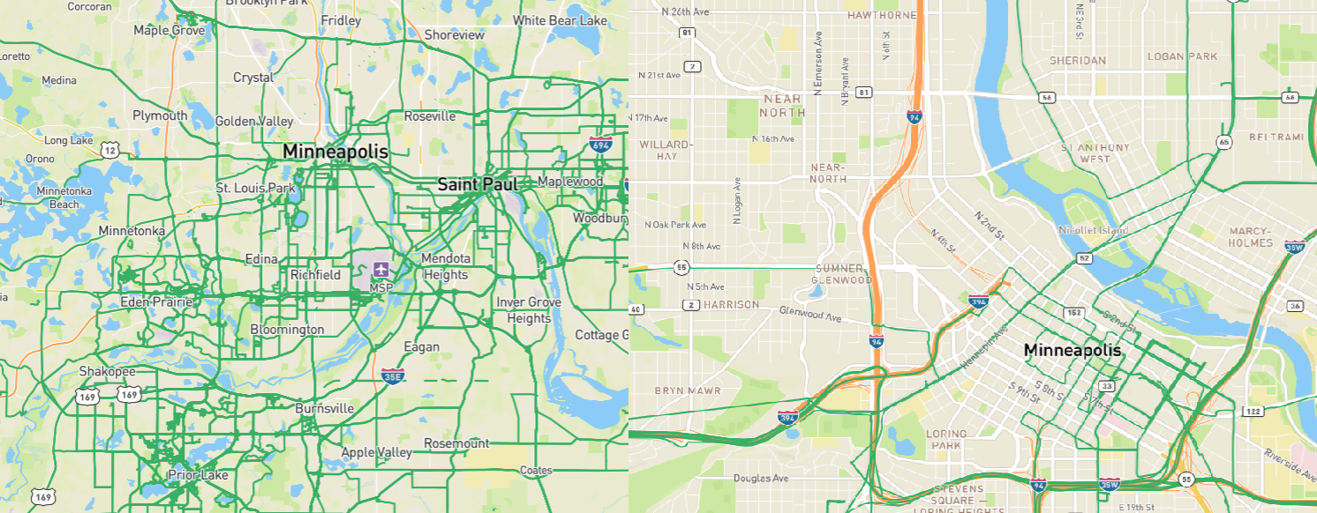
Minneapolis – St. Paul

Slide 3

Agenda
Prep cameras
Capture photos
Upload
Learn

Slide 4


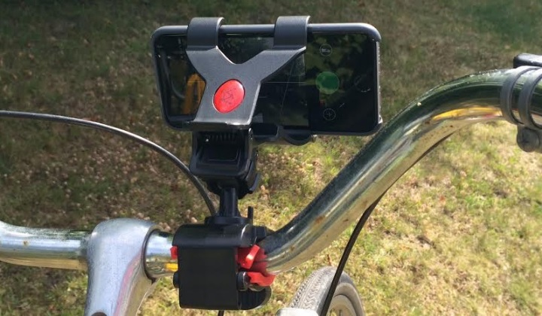
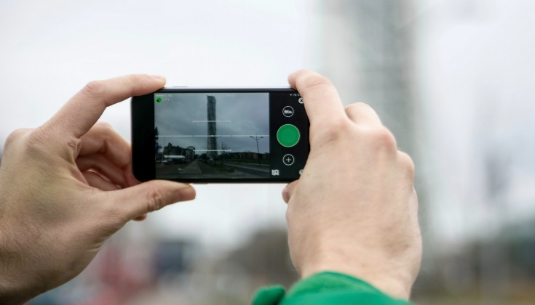


Diving in
Bicycle Mount
Mobile App
Install Mapillary mobile app
Optional: install LG 360 app

Slide 5

Capturing Photos

Slide 6
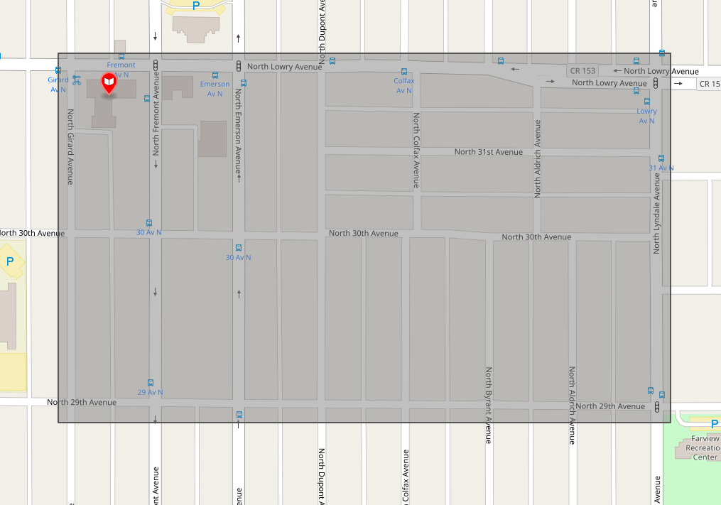
Let’s map!

Slide 7
Introducing Mapillary

Slide 8
Our Technology
Street-level imagery – contributed by all, available to all
Building computer vision solutions for generating map data from photos
Using map data to improve maps—public, private, nonprofit, academic, cultural, historic, and more
All data is available for free use on OpenStreetMap
Commercial users must license the data

Slide 9
Integrations
Mapillary for ArcGIS Online
edit existing maps, point data in photos, ground level context
Mapillary for ArcGIS Pro
create and edit datasets, compare photos over time
Mapillary Web AppBuilder widget
compatible with ArcGIS Portal, configurable in WAB developer edition

Slide 10
What we do for you

Slide 11
Mapillary functions
Efficient DIY photo capture
Upload and hosting
Navigable photo sequences
Structure from Motion
Image Recognition
GIS data

Slide 12

Structure from Motion (SfM)
Estimating three-dimensional structures and camera motions
from image sequences.

Slide 13
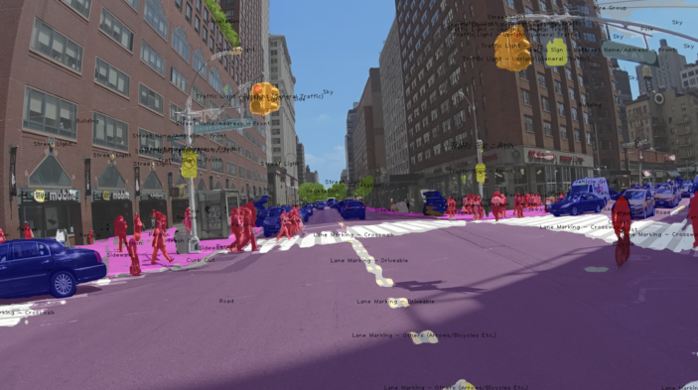
Semantic Segmentation
Label each pixel in an image with a class of objects e.g. sky, tree, car ..
Currently supports 72 object classes (100+ classes annotated)
4-lever target: 80 classes

Slide 14
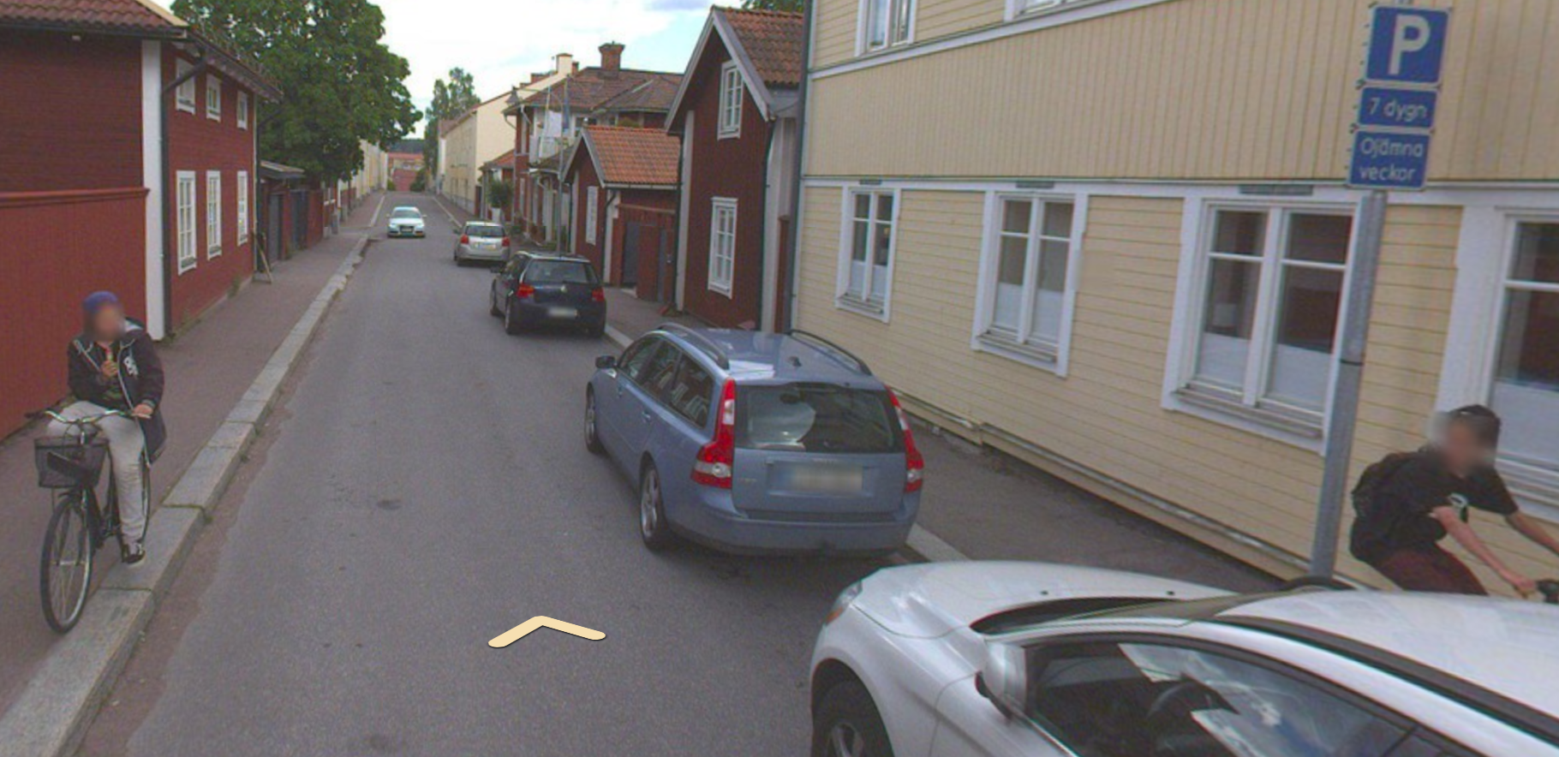
Face and license plate detection
Detect and blur faces and license plates for privacy protection
.
Falun, Sweden

Slide 15
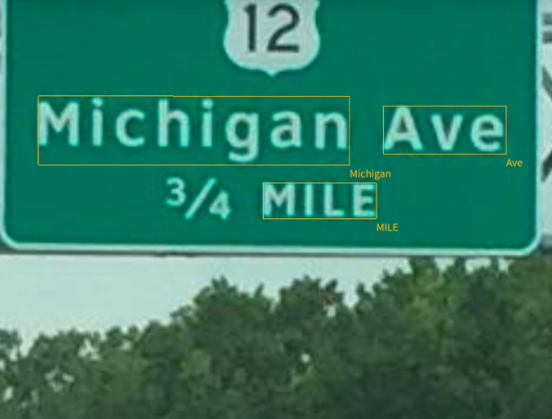
Text Recognition
- Detect and recognize texts on highway signs
.

Slide 16
SfM + Recognition
3D structures from SfM
+
Semantic information from Recognition
Map Objects

Slide 17
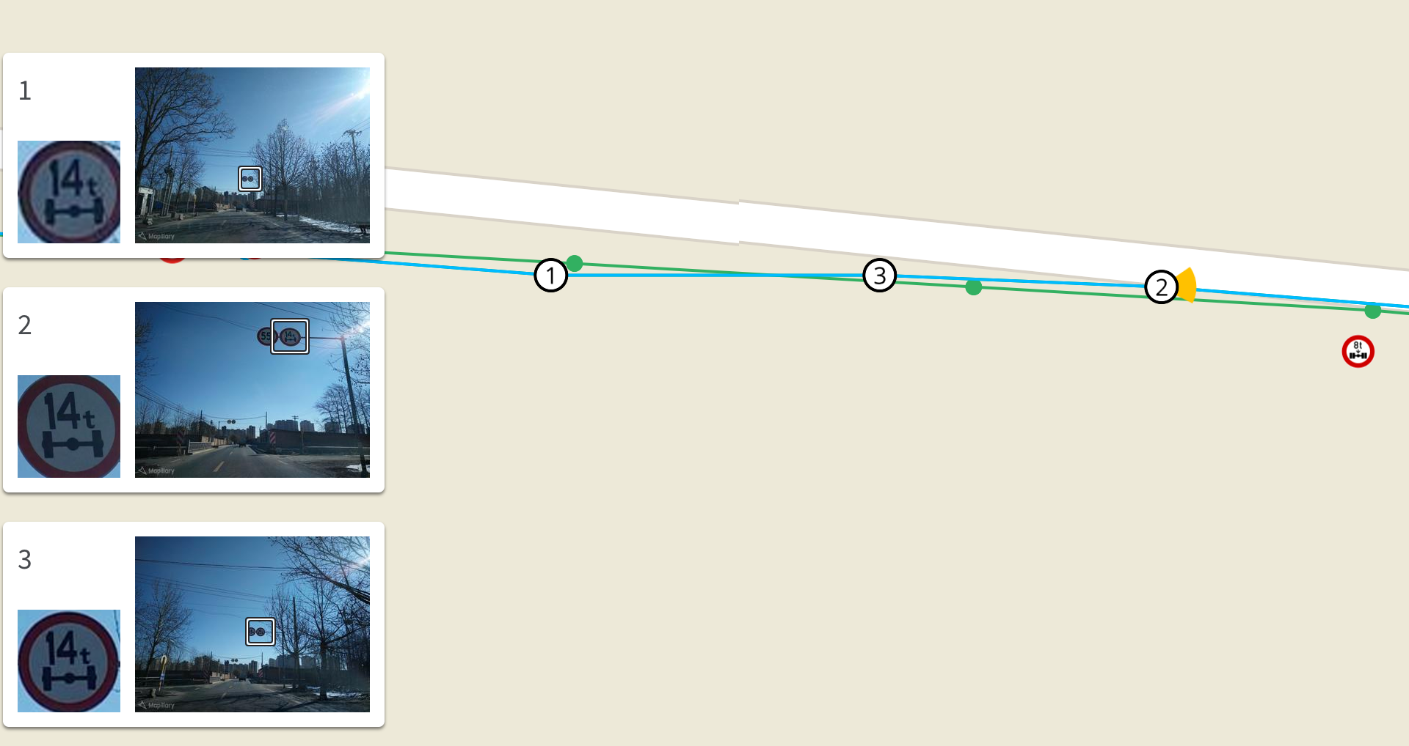
Traffic Sign Map Objects

Slide 18
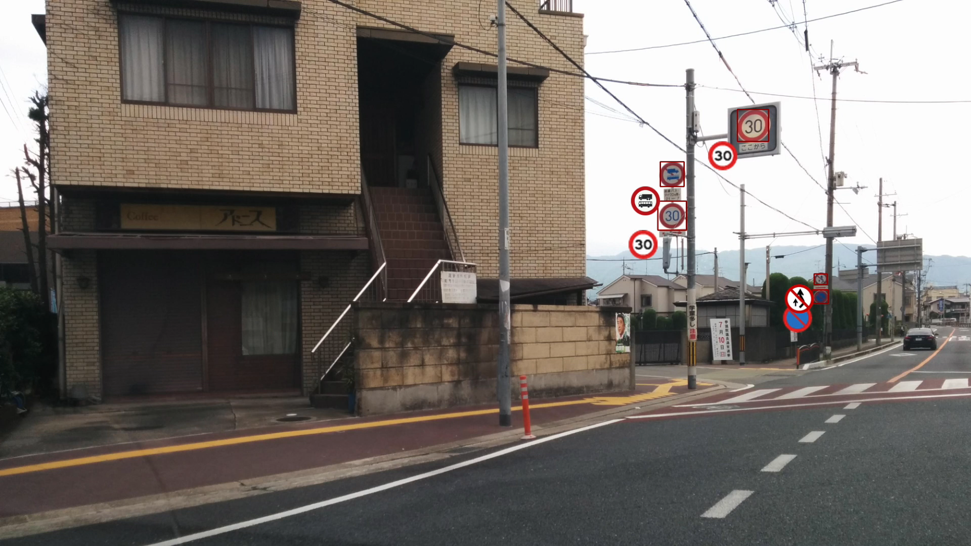
Traffic Sign Recognition
Detect and recognize traffic signs
Supports ~900 signs across ~60 countries
.
Japan

Slide 19
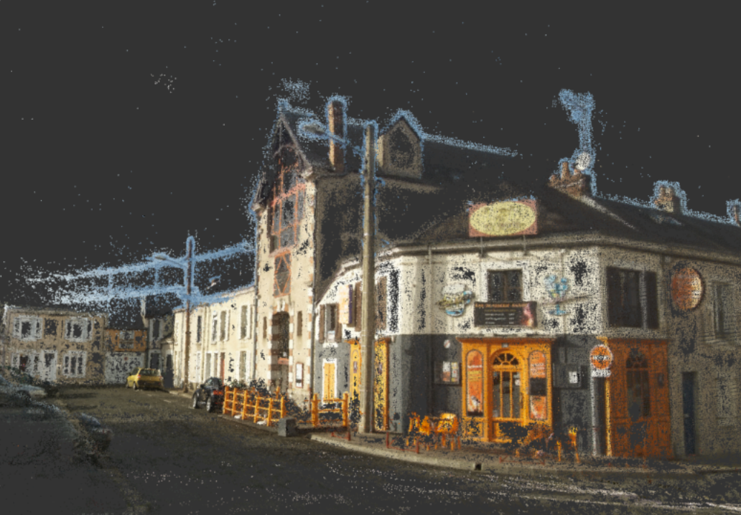

Slide 20
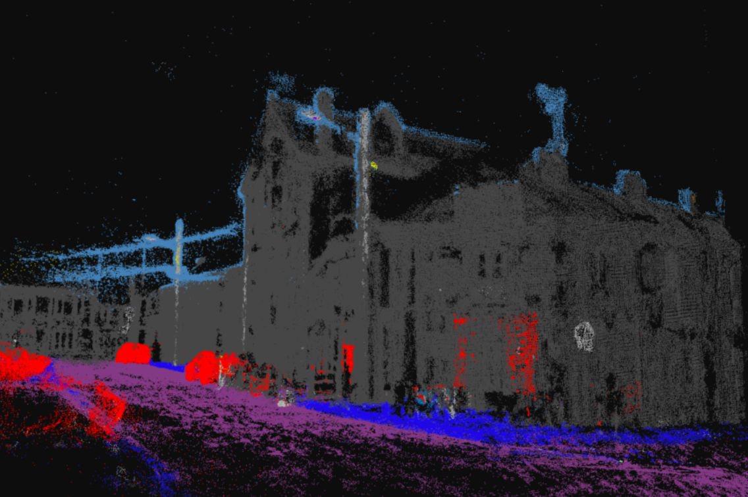
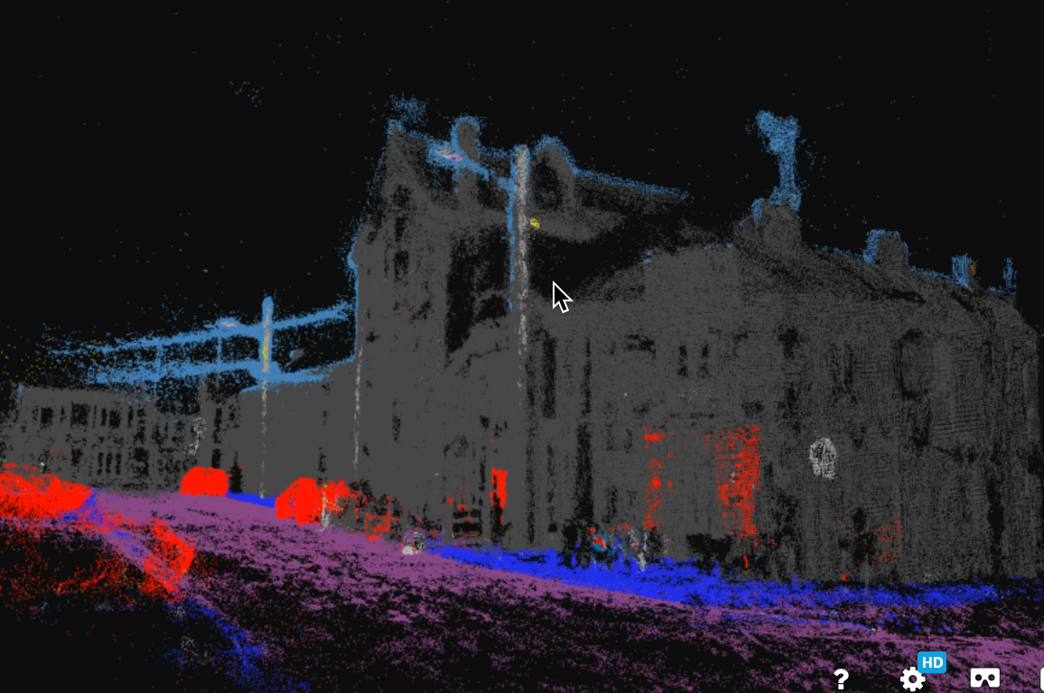

Slide 21
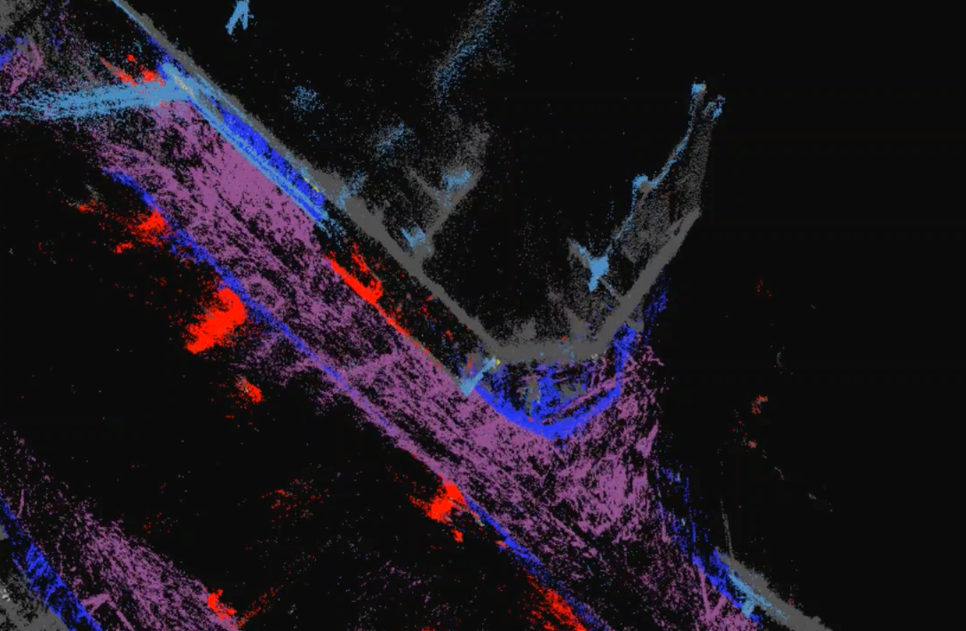

Slide 23
Building
Curb
Sidewalk
Street Light

